Slide 1
MATHEMATICS
CALCULUS

Slide 2
Applications of Derivatives

Slide 3
Maxima and Minima

Slide 4
Maxima of a function
A function is said to have a maxima at if
the value of the function at is greater than any
other value of in a neighborhood of . That is
for a small and for all we
have . The value of is called the
Maxima of . Thus the function will have
maxima at if is increasing in
and decreasing in .

Slide 5
Minima of a function
A function is said to have a minima at if
the value of the function at is less than any
other value of in a neighborhood of . That is
for a small and for all we
have . The value of is called the
Minima of . Thus the function will have
minima at if is decreasing in
and increasing in .

Slide 6
Points to remember
(1) If then at the function is neither
increasing nor decreasing , such a point on the curve is
called turning point or stationary point of the function.
Any point at which the tangent to the graph is parallel to
X-axis is called a turning point. We can locate the turning
points by looking for points at which . At these
points if the function has a Maxima or Minima then these
are called extreme values of the function.

Slide 7
(2) First Derivative Test.

Slide 8
(5) Second Derivative Test.

Slide 10
Examples
(1) Find the maximum and minimum value of
Solution : Given,

Slide 13
(2) A wire of length 120 meters is bent in the form of a rectangle. Find its dimensions if the area of the rectangle is maximum.
Solution :

Slide 15
Area of the rectangle is maximum if length = breadth = 60 cm.

Slide 16
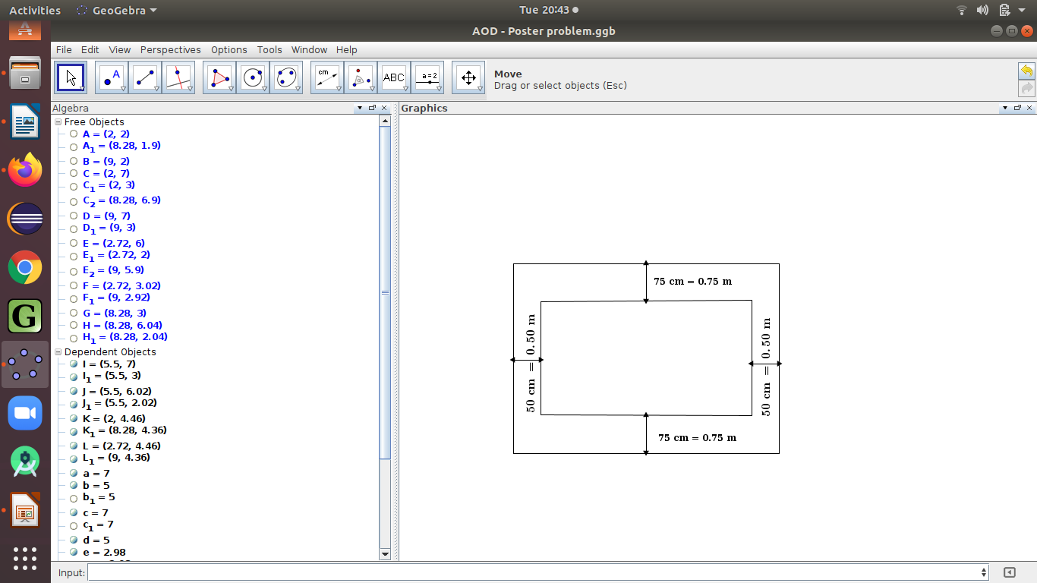
(3) A Rectangular sheet of paper has it area 24 sq
meters. The margin at the top and the bottom are
75 cm each and at the sides 50 cm each. What are
the dimensions of the paper, if the area of the
printed space is maximum ?
Solution : Let
be the length and breadth of the
rectangular sheet of paper
respectively.
Area of the sheet of paper = 24 sq .m

Slide 19
When Area of the rectangular printing space is maximum.

Slide 20
(4) An open box is to be cut out of a piece of square card board of side 18 cm by cutting off equal squares from the corners and turning up the sides. Find he maximum volume of the box.
Solution :

Slide 21
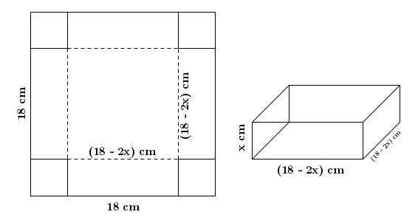
x

Slide 23
(5) The slant side of a right circular cone is . Show that the semi-vertical angle of the cone of maximum volume is
Solution :

Slide 24
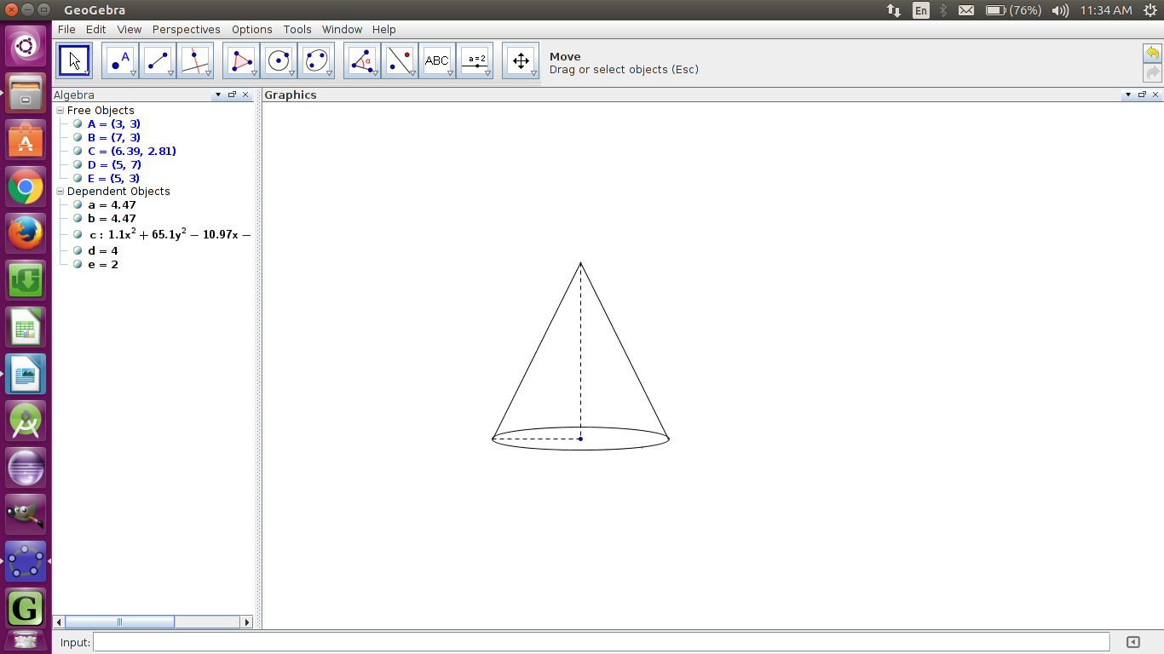
For maximum volume,

Slide 27
(6) Find the height of a covered box of fixed volume so that the total surface area of the box is minimum whose base is a rectangle with one side three times as long as the other
Solution :

Slide 28
Since the volume is fixed,

Slide 29
Let be the surface area of the box.

Slide 30
For minimum surface area

Slide 31
###### DONE ######

Slide 32
T H A N K Y O U

